Slide 1
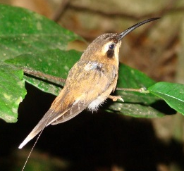
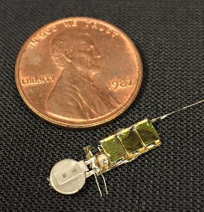
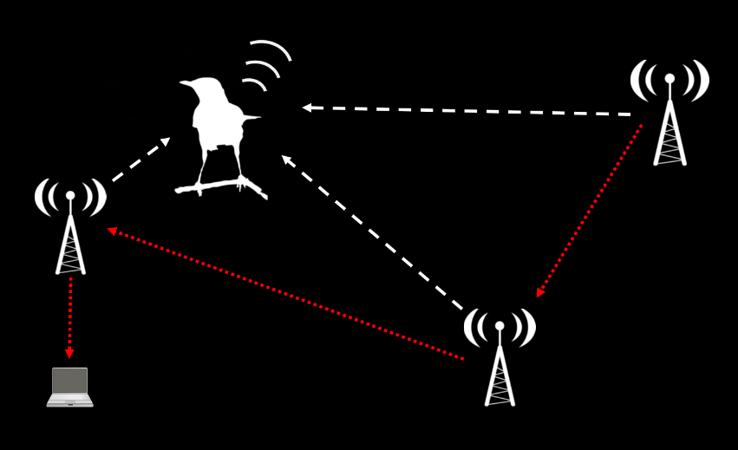
AMRUPT (Animal Movement Research Using Phase-based Trilateration)

Slide 2
Requirements and constraints
Short range (100-300 m between receivers)
Extremely simple transmitter design (lightweight, low power)
System can operate in cluttered environments (multipath interference)
System can operate with ~50 Txers
High spatial accuracy (~5 m) triangulation results
Low cost receivers (COTS components)
Low power consumption of receivers

Slide 3
signal
Receiver architecture
control
I/Q 1
Antenna 1
LNA
RF Switch
CC1310
Watson-Watt pair 1
Antenna 2
LNA
I/Q 2
I/Q 1-4,
RSSI 1-4, ID
DF Algorithm running on RaspberryPi
LNA
SPI
Antenna 3
I/Q 3
Watson-Watt pair 2
AOA,
RSSI,
ID,
Time
Antenna 4
LNA
I/Q 4
Notes:
TDOA

Slide 4
Data
4 antennas – allows for Watson-Watt AOA measurement
LNA – Improved SNR
4 RF switches and noise generator – switching in RF noise calibrates for initial phase offsets due to program execution differences
RTL-SDR – cheap ($20) SDRs which can be synchronized with a common local oscillator, and fast I/Q sampling (2 Msps)
Clock – dedicated board with highly stable (0.1 ppm) TCXO and enough drive strength for multiple SDRs, synchronize SDRs
Raspberry Pi – cheap interface for DSP, and to control Clock, Noise generator, RF switches, and SDRs
Data/Control
Control
Clock
Antenna 1
LNA
RF switch
RTL SDR
Raspberry Pi
Antenna 2
LNA
RF switch
RTL SDR
Antenna 3
LNA
RF switch
RTL SDR
Antenna 4
LNA
RF switch
RTL SDR
Noise generator

Slide 5
Data
Data/Control
Control
Clock
Antenna 1
LNA
RF switch
RTL SDR
Raspberry Pi
Antenna 2
LNA
RF switch
RTL SDR
What about transmitting commands to the mobile nodes?
CC1310
Antenna 3
LNA
RF switch
RTL SDR
Antenna 4
LNA
RF switch
RTL SDR
Noise generator

Slide 6
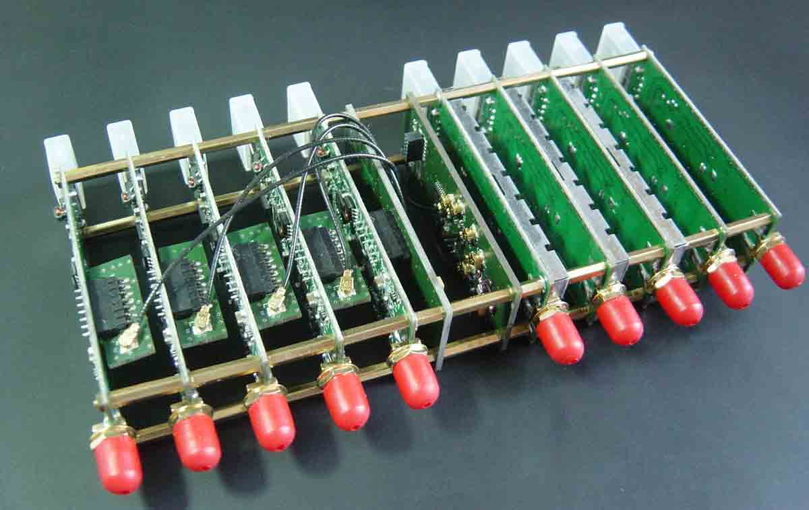
Boards available from www.coherent-receiver.com

Slide 7
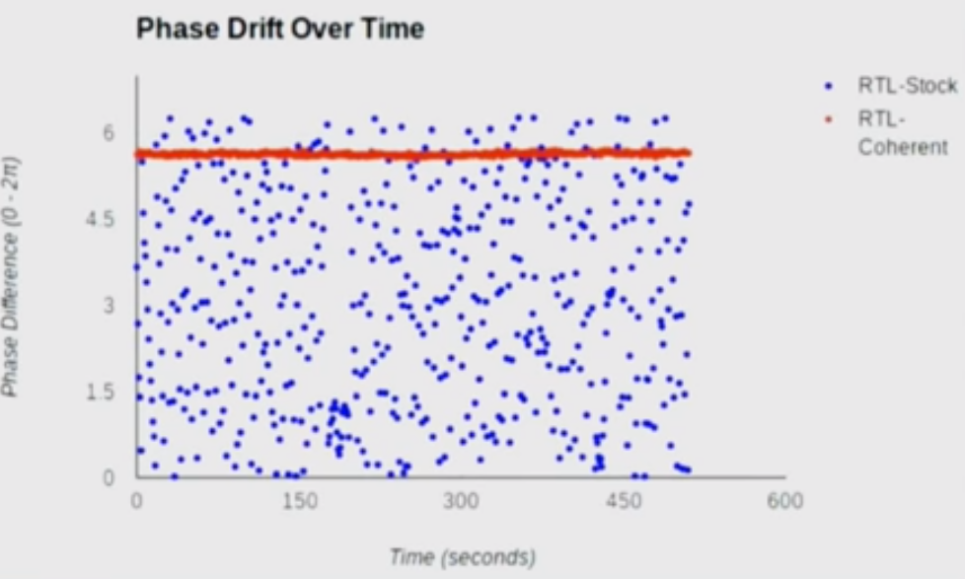
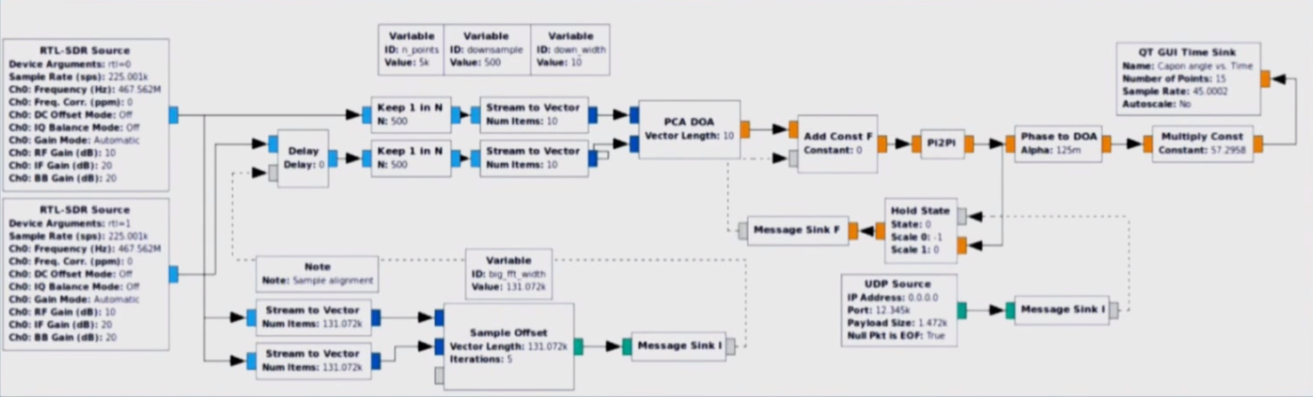
Software/DSP: GNU Radio
Calibrate for constant phase offset between 2 channels w/ switched-in RF noise signal (?)
2 RTL-SDRs
Downsample to 1.5 ksps
Phase diff.
Compensate for time delay using Xcorr w/ switched-in RF noise signal

Slide 8
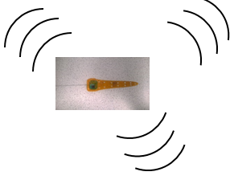
TRX 1
Automated phase-based telemetry receiver system
TRX 2
Local
Oscillator
Local
Oscillator
Antenna 1
Low Noise
Amplifier
CC1310 1
Antenna 1
Low Noise
Amplifier
CC1310 1
Antenna 2
Low Noise
Amplifier
CC1310 2
DF Algorithm running on RaspberryPi
Antenna 2
Low Noise
Amplifier
CC1310 2
DF Algorithm running on RaspberryPi
Antenna 3
Low Noise
Amplifier
CC1310 3
Antenna 3
Low Noise
Amplifier
CC1310 3
Antenna 4
Low Noise
Amplifier
CC1310 4
Antenna 4
Low Noise
Amplifier
CC1310 4
GPS
RxTx communication protocol
Compass
Energy harvesting
Time-keeping,
coordination w/txrs
coordination w/ rxrs
localization of receivers
Orienting antenna elements
TRX3
TRX4
Local
Oscillator
Local
Oscillator
Antenna 1
Low Noise
Amplifier
CC1310 1
Antenna 1
Low Noise
Amplifier
CC1310 1
Antenna 2
Low Noise
Amplifier
CC1310 2
DF Algorithm running on RaspberryPi
Antenna 2
Low Noise
Amplifier
CC1310 2
DF Algorithm running on RaspberryPi
Antenna 3
Low Noise
Amplifier
CC1310 3
Antenna 3
Low Noise
Amplifier
CC1310 3
Antenna 4
Low Noise
Amplifier
CC1310 4
Antenna 4
Low Noise
Amplifier
CC1310 4

Slide 9

TRX 1
Automated phase-based telemetry receiver system
TRX 2
Local
Oscillator
Local
Oscillator
Antenna 1
Low Noise
Amplifier
CC1310 1
Antenna 1
Low Noise
Amplifier
CC1310 1
Antenna 2
Low Noise
Amplifier
CC1310 2
DF Algorithm running on RaspberryPi
Antenna 2
Low Noise
Amplifier
CC1310 2
DF Algorithm running on RaspberryPi
Antenna 3
Low Noise
Amplifier
CC1310 3
Antenna 3
Low Noise
Amplifier
CC1310 3
Antenna 4
Low Noise
Amplifier
CC1310 4
Antenna 4
Low Noise
Amplifier
CC1310 4
GPS
RxTx communication protocol
Compass
Energy harvesting
Time-keeping,
coordination w/txrs
coordination w/ rxrs
localization of receivers
Orienting antenna elements
Node-to-node VHF uplink
TRX3
Trilateration / triangulation algorithm
TRX4
Local
Oscillator
Bluetooth / VHF uplink to central hub
Local
Oscillator
Antenna 1
Low Noise
Amplifier
CC1310 1
Antenna 1
Low Noise
Amplifier
CC1310 1
Antenna 2
Low Noise
Amplifier
CC1310 2
DF Algorithm running on RaspberryPi
Antenna 2
Low Noise
Amplifier
CC1310 2
DF Algorithm running on RaspberryPi
Antenna 3
Low Noise
Amplifier
CC1310 3
Antenna 3
Low Noise
Amplifier
CC1310 3
Antenna 4
Low Noise
Amplifier
CC1310 4
Antenna 4
Low Noise
Amplifier
CC1310 4

Slide 10
Phases of AMRUPT project
Phase I (Spring 2018)
Basic AOA calculation with single 4-element SDR receiver
Simple narrowband Tx (~150 MHz)
Phase II (Summer 2018)
Refined AOA calculation with multiple 4-element SDR receivers
HMFCW signals and phase error threshold to refine AOA in cluttered environments
Basic triangulation algorithms
Phase III (Fall 2018)
Phase cycle integer disambiguation with multiple 4-element SDR receivers
Resolve ambiguous cycle integer of received HMFCW signals for ranging
Advanced hyperboloid trilateration algorithm
Phase IV (?)
Refinements:
Watson-Watt (RSSI-based)
TDOA system with timing beacons
Will these help phase integer disambiguation algorithm’s parameter space?

Slide 11
Mobile-to-Ground Node Communication Protocol
5 + X s
5 min – (5 + X s)
Tx
Rx from mobile nodes
5 s
X (?) s
Ground node
(acquire or sleep mode)
Tx countdown signal (5 s)
Tx commands
e.g. timestamp & checksum
e.g. timestamp & checksum
0.0000
Y IDs
Y commands
*Will need a data upload mode too
Checksum (opt.)
Global time
Sleep command
Y
Sleep length
X
Listen for tags
X
Y
X
N
Default?
N
Special commands for Y tags
*Give mobile nodes way to check that they have a good link
*All mobile nodes sync’d here
*Keeps all mobile nodes from TXing when system isn’t monitoring
*Default mode just has any tag within range of sync signal transmit at its scheduled time
*Special commands allow a subset of tags to be told to go to sleep, switch to different mode (e.g. to upload sensor data on different channel), etc.
Notes:
Mobile node diagram to follow. Mobile nodes should sleep just under 5 s (ensuring they will hear a ground node transmission at least once if it is in range), then wake long enough to receive a single countdown signal from a ground node. Once they have received a countdown signal, and the checksum demonstrates a good link, update global time (it will have drifted over the last 5 min), then listen for rest of commands. Once commands received use global time, received command, and (assuming the command includes a simple transmit instruction) pre-programmed transmission time delay to send ID during the ground node’s ~5 min RX period.

